Slide 1
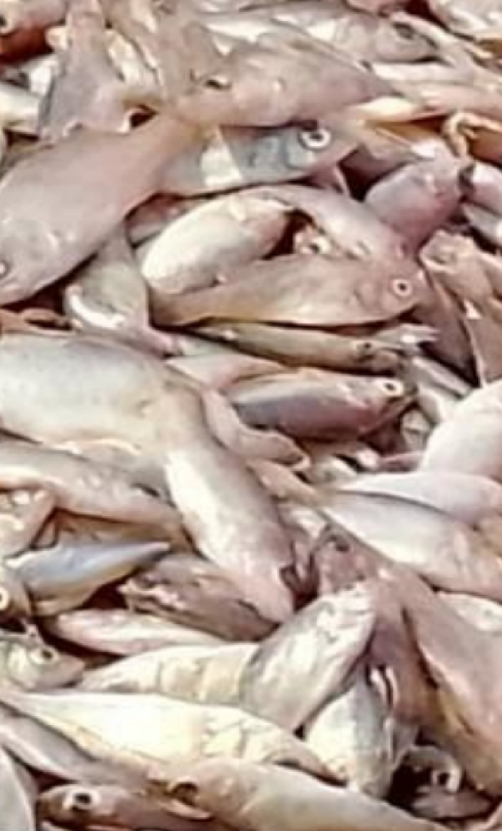
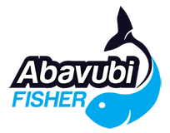
ABAVUBI FISHER
A Digital Platform
A Comprehensive "Lake-to-Ministry" Ecosystem for Security, Revenue Assurance, and Sustainable Fisheries.

Slide 2
The Vision
From Unregulated Waters to a National Asset.
The Goal:
A national blue economy digitization program designed to eliminate IUU fishing and revenue leakage through a sovereign, end-to-end digital infrastructure
Security
Transparency
Sustainability
Protecting breeding sites to ensure future yields
Real-time maritime domain awareness.
End-to-end visibility from the catch to ledger.
Notes:
Slide 2: The Vision
The Core Shift: Our goal is to move all Ugandan water bodies from an unregulated fishing economy to a digitized, secure, and taxable national asset.
The Partnership Model: This is achieved by synergizing the Government of Uganda’s enforcement and regulatory capabilities with the data-driven oversight of the ABAVUBI FISHER platform.
The Triple-Bottom-Line Value Proposition:
We are committed to reducing overfishing and eliminating illegal practices.
We provide the tools to secure the livelihoods of our fishers.
By extension, we are securing the future of the entire community living within the lakes.
We aren't just building an app; we are building an ecosystem that ensures 100% End-to-End visibility—what we call the "Lake-to-Ministry" journey.

Slide 3
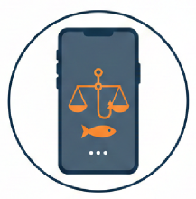

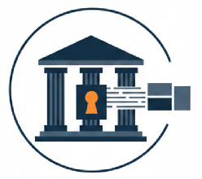
The Solution
One Platform. Total Ecosystem Control
The "Omni" Philosophy:
A central Platform-as-a-Service (PaaS) that acts as the data and API service centre for all maritime stakeholders.
ABAVUBI FISHER
ABAVUBI FORCE
ABAVUBI GOV
A frontline module to report catches and manage finances.
Tactical surveillance and GPS tracking for the UPDF Marines.
Secure API gateway for URA fiscal oversight and MAAIF regulation.
Notes:
Slide 3: The Solution
The "Omni" Philosophy:
We are introducing an all-encompassing digital environment that establishes a "Lake-to-Ministry" value chain. This ensures that the journey of a single fish—from the water to the URA ledger—is tracked with 100% end-to-end visibility.
The Data and API service Center (is ABAVUBI OMNI): At the heart of this is a central Platform-as-a-Service (PaaS). It acts as the data nerve center, managing vessel registries, biometric user data, GPS logs, and product weights.
The End User Interface (ABAVUBI FISHER): This is the interface for our primary stakeholders on the ground. It allows fishers and landing-site officers to report catches, manage finances, and enables buyers to verify that their fish was sourced legally.
The Shield (ABAVUBI FORCE): This module is dedicated to surveillance and enforcement. By providing real-time GPS tracking and logging, it empowers the UPDF Marines and field officers to monitor the lake and protect breeding sites from illegal incursions.
The Gateway (ABAVUBI GOV): Finally, we provide a secure API access layer for the government. This opens the door for URA [as the plaform acts as a fiscal bridge to the blue economy] and for MAAIF to exercise regulatory oversight with real-time data.
Strategic Branding:
By utilizing the "Omni" branding, we have moved beyond a simple app to claim the entire maritime ecosystem, making it a robust, national-scale solution.

Slide 4
National Vessel Database (NVD)
Every boat and ship is registered as a unique, traceable asset within the ABAVUBI OMNI repository.
Omniscient
(“The Digital Brain")
Abavubi Digital Census (ADC)
Every stakeholder active within the lakes is registered; from the fishermen, landing site officers, to patrol units.
Intelligence That Never Stops Growing
The Fiscal Bridge
System provides a secure gateway for URA to synchronize tax compliance and revenue collection in real-time.
Notes:
Slide 4: The Digital Brain
The Omniscient Paradigm:
ABAVUBI OMNI acts as the digital brain of Uganda’s blue economy, maintaining a state of omniscience by consolidating every data point into a single, intelligent repository.
We begin with the foundation of the database: the Vessel Registry. Every boat is registered as a unique national asset within the OMNI database.By capturing technical specs, engine serial numbers we can prevent illegal "engine swapping".
Second, a brain is only as good as its memory of the people involved. We have to register every person active within the lakes and the broader industry. By integrating National IDs (NIN) and biometrics, the system knows exactly who is authorized to be on the water at any given time.
As for the Fiscal Bridge, this is where data becomes wealth. Through the GOV module we can convert unrecorded fish catches into measurable, taxable economic value. Through e-invoicing and synchronization with URA's system, we eliminate the revenue leakage caused by tax defaulters.
The "All-Knowing" Advantage:
This platform provides a complete, all-knowing view of the blue economy. It allows for precise fish stock management for MAAIF and enhanced maritime domain awareness for the UPDF Marines. It is a system that grows smarter with every data entry, ensuring the lake is managed as a transparent and profitable national resource

Slide 5
Biometric Linkage:
Every vessel is digitally tied to a verified operator via fingerprints, high-resolution photos and NIN/TIN integration.
Omnispective
(“The Digital Eyes")
Dual-Communication Monitoring:
Utilizing LoRaWAN for low-power, long-distance tracking in remote areas where LTS (4G/5G) signals fail.
Intelligence That Never Sleeps.
Smart Geofencing:
Automatic alerts triggered if vessels enter "No-Go" breeding zones according to programmed hours.
Notes:
Slide 5: The Digital Eyes
The Omnispective Paradigm:
Omnispective is pronounced om-nuh-SPECK-tiv
Our "Omnispective" approach provides a 360-degree, real-time perspective of all activities within the lake ecosystem. By moving beyond traditional monitoring, we provide you with the total situational awareness required to manage the blue economy effectively.
Biometric Linkage (The Human-Vessel Bond): We are moving beyond just tracking boats; we are tracking accountability. By building a Digital Census, every vessel is digitally locked to a verified operator using fingerprints, high-resolution photos, and National ID (NIN) or Tax ID (TIN) integration.
This creates a digital manifest that ensures only authorized personnel are on the water, effectively eliminating "ghost crews".
Dual-Communication Monitoring: To maintain our omnispective view in the most remote areas, we utilize a dual-communication strategy for surveillance. By leveraging LoRaWAN (Long Range Wide Area Network) for long-distance tracking, we ensure that even when 4G or 5G (LTS) signals fail, the FORCE module remains live, and boats remains visible to command centers.
Smart Geofencing: Our "Digital Eyes" will be programmed with intelligence. We will hard-code "No-Go Zones" around protected breeding sites. This way the system will triggers an automatic, real-time alert to the Marines on patrol if a vessel enters these coordinates, particularly during night hours.
The "All-Seeing" Advantage:
Ultimately, being "Omnispective" means we eliminate the "blind spots" that have historically allowed IUU fishing to thrive. Whether it is for enforcement, search and rescue, or revenue collection, the platform ensures that the lakes are no longer a "shadow economy," but a transparent national asset.

Slide 6


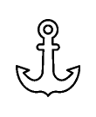
Economic & Security Impact
Driving Compliance and Prosperity.
For the Fisherman
(Financial Inclusion)
For the URA
(Fiscal Assurance)
Legal protection from harassment and a "digital-catch-history" to unlock bank and SAACO loans.
Real-time e-invoicing ensures every kilogram of fish is taxed at the source.
For Exporters
(Market Access)
For the Marines
(Operational Supremacy)
Full "Lake-to-Plate" traceability required for international markets, especially in the EU
Enhanced maritime awareness and accurate Search and Rescue (SAR) through digital manifests.
Notes:
Slide 6: Economic & Security Impact
ABAVUBI OMNI is not just a tracking tool—it is an economic engine. By digitizing the lake's activities, we create value for every stakeholder in the chain, moving from a "poverty" mindset to a "prosperity" mindset.
For the URA (Fiscal Assurance): Through the ABAVUBI GOV module, a online e-invoicing is triggered at the landing site. This ensures that every kilogram of fish is weighed, recorded, and taxed at the source, effectively closing the gap on tax defaulters.
For the Marines (Operational Supremacy): Beyond catching illegal fishers, the digital manifest system allows for pinpoint accuracy during Search and Rescue (SAR) missions. If a vessel is distressed, the Marines know exactly who is on board and where they were last seen.
For the Fisherman (Financial Inclusion): For the law-abiding fisherman, this platform is a shield. It provides legal protection from harassment by proving their compliance instantly. Furthermore, their "Digital Catch History" acts as a formal financial record, allowing them to approach commercial banks for credit and loans for the first time.
For Exporters (Market Access): International markets, especially the EU, now demand rigorous "Lake-to-Plate" traceability. Our system provides the data-backed certificate of origin that exporters need to prove their fish was caught legally and sustainably, unlocking premium pricing for Ugandan fish on the global stage.

Slide 7
The Roadmap to Implementation
A Structured Deployment Model
Phase II:
Hardware Integration
(Manufacturing & Testing)
Phase IV:
Full Rollout
(National Scale)
Assembling the ruggedized GPS tracking units with LoRa + LTE dual-stack. Including stress testing the FORCE protocols.
Full-scale rollout across Uganda.
This phase includes activation of the GOV API, providing partners with real-time data.
Phase I:
Foundation
(Registry Infrastructure)
Phase III:
Operational Validation
(Pilot Lake Deployment)
Deploying the frontline module with the Vessel Registry and Stakeholder Census databases. This includes building a biometric "Source of Truth".
Live deployment of FORCE tracker at selected landing site, and training the Marine/patrol officers how to use the FORCE interface.
Notes:
Slide 7: Roadmap to Implementation
Phased Success: We are not proposing a 'big bang' launch. We are proposing a disciplined, four-phase rollout that ensures the system is stress-tested before it goes national.
De-risking the Project: Phase I and II are about building and deploying the infrastructure. We don't move to the water until we have verified every stakeholder biometrically. This eliminates identity fraud before the trackers are even installed.
The Power of the Pilot: In Phase III, we work side-by-side with the Marines. By refining the alerts the officers on patrol are actionable—ensuring that when there's a 'Breeding Site Intrusion' alert pings, the patrol knows exactly which boat it is and who is driving it."
The End Goal: By Phase IV, Lake Victoria—and eventually all Ugandan waters—becomes a transparent, digitized asset. This is where the 'Fiscal Bridge' is fully crossed, and URA begins to see the true economic value of our blue economy."

Slide 8
Security & Sovereignty
Protecting Uganda’s Data
Data Sovereignty
Compliance
Adoption
All national economic and citizen data is hosted securely within Uganda.
On-ground digital literacy programs to ensure 100% stakeholder proficiency.
Fully aligned with the Data Protection and Privacy Act.
Notes:
Slide 8: Security & Sovereignty
The Trust Mandate:
When dealing with National IDs, biometric data, and military patrol patterns, security isn't just a feature—it’s a prerequisite. This slide outlines our commitment to protecting the integrity of Uganda's digital borders.
Data Sovereignty (National Control): We strictly adhere to the principle of Data Sovereignty. All national economic data, vessel tracking logs, and citizen biometrics are hosted securely within Uganda. This ensures that the Government maintains absolute control over its critical infrastructure and prevents foreign or unauthorized entities from accessing sensitive blue economy intelligence.
Regulatory Compliance: The ABAVUBI OMNI platform will be fully aligned with the Data Protection and Privacy Act. With this in mind, we will utilize industry-grade encryption for the FORCE module to ensure that vessel movements are visible only to authorized personnel, protecting the tactical advantage of the UPDF Marines.
Addressing Adoption Risk: A system is only as secure as its users are competent. To ensure 100% stakeholder proficiency, we will have on-ground Digital Literacy programs during the pilot test, and final national rollout. As we go to the landing sites to train fishers and officers, we'll ensure that the transition from paper to the "Omni" philosophy is seamless and inclusive.
Anti-Tamper Infrastructure: Lastly, our hardware is developed with security by design. Any attempt to disconnect or spoof a GPS tracker triggers an immediate alert to the Command Center, ensuring the system remains tamper-proof in the field.

Slide 9
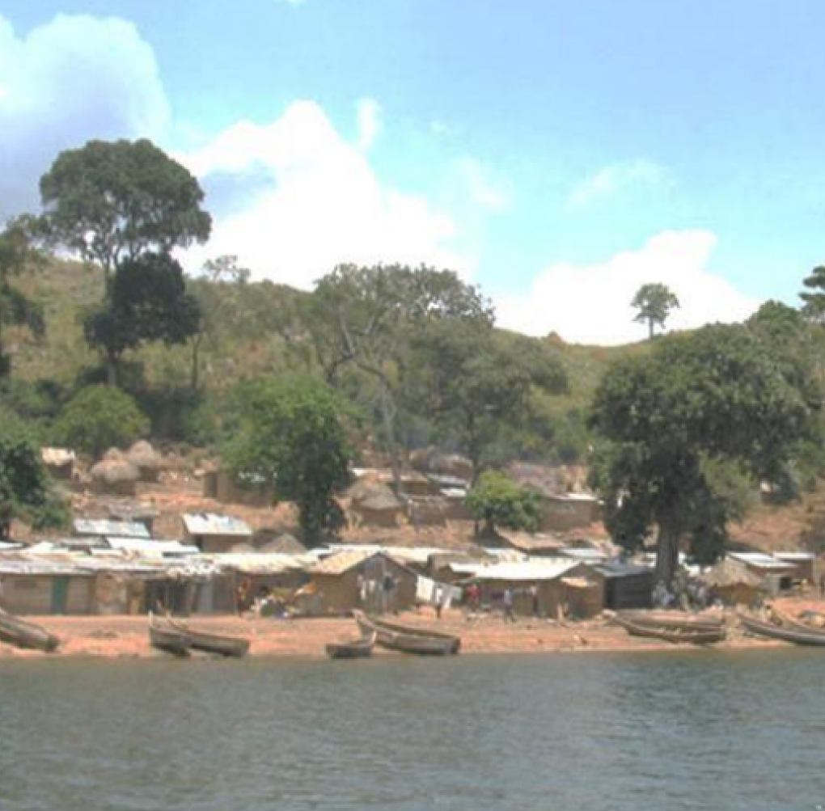
Conclution
Secure the Water. Secure the Future.
Notes:
Let us partner to turn our lakes into a world-class, transparent, and highly profitable blue economy hub.

